Slide 1
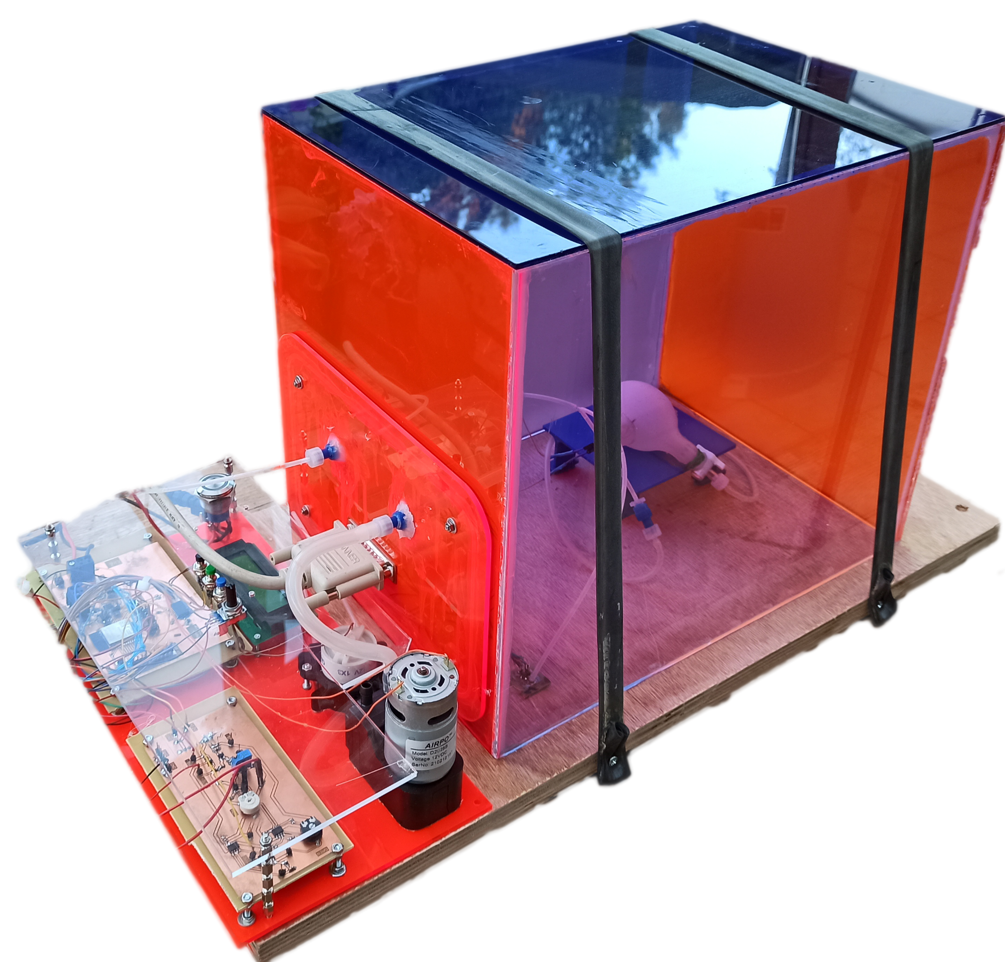
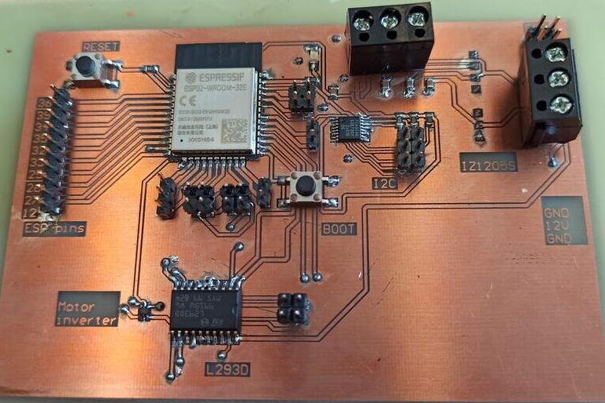
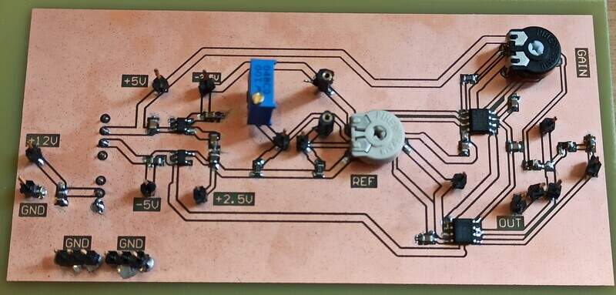
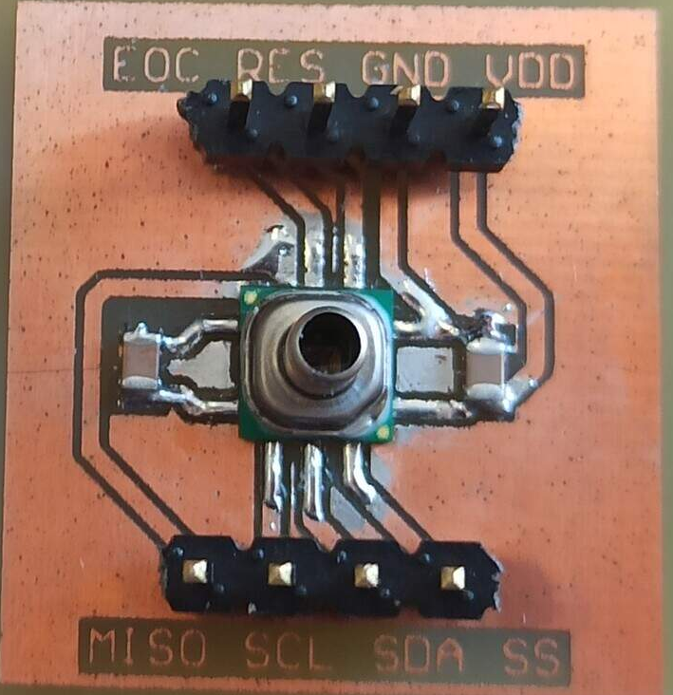
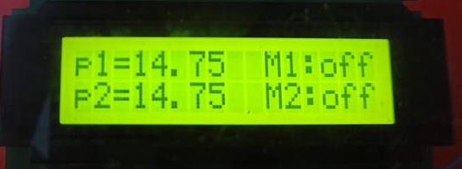

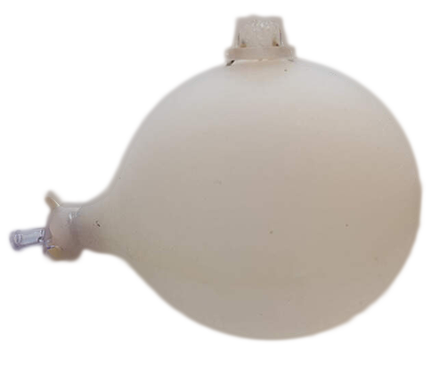
Pressure controlled chamber and silicone phantom for bladder modelling
Control panel
Peristaltic and vacuum pump
ESP32 based pump actuation pressure and strain measurements
Laser cut and CNC machined pressure chamber
LCD screen
Silicone bladder phantoms
Maxime Verstraeten
Fab Academy 2021 | Fablab ULB

